Slide 1
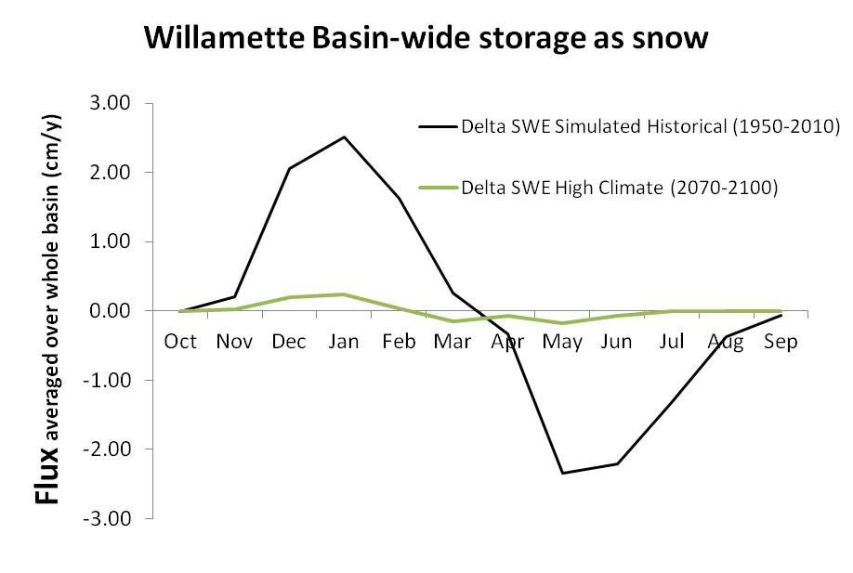
Flux has units of cm³/cm²/y which simplifies to cm/y. The denominator 'cm²' is based on the entire Willamette Basin, not just irrigated ag land. While this is not ideal for a discussion isolated to irrigated agriculture, it is useful for comparing the water budget of the whole basin, which is the original context for this figure.
This project is supported by the National Science Foundation under Grants #s 1039192, 1038925 and 1038899. This project is part of the NSF Water Sustainability and Climate program.

